Slide 1
Reyinyon Anyèl Tit I
Haitian Creole version
Yon prezantasyon an Kolaborasyon avèk Pwogram Depatman Federal ak Leta ak Lekòl Title I yo
Notes:
Presenter dialogue –
Welcome to [inset your school’s name] Title I Annual Meeting. Thank you for attending!
Introduce speaker and other school personnel in attendance. Today, you will learn what it means to be a Title I school, come to understand the rights you have as a parent or family member of a child who attends a Title I school, and the opportunity to request regular meetings. During the presentation, we will share specific information about the Title I program and will answer any questions you might have about Title I and our school.

Slide 2
Objektif Reyinyon an
Lwa pou Chak Elèv Reyisi a (Yon lwa federal) mande lekòl Tit I yo pou fè yon Reyinyon Anyèl pou eksplike epi diskite pwogram Tit I lekol yo, dwa paran, ak lòt obligasyon lekòl yo.
Yo ankouraje fanmi yo pou poze kesyon epi bay sijesyon pou amelyore pwogram Tit I lekòl yo.
Notes:
Presenter dialogue –
According to federal guidelines, every Title I school must hold an informational Annual Meeting. The meeting allows parents and family members to better understand the importance of their role in their child’s education.
It also gives us an opportunity to ask for your input to help us improve our Title I program.
So what is Title I?

Slide 3
Kisa Tit I an ye?
Tit I an fè pati yon lwa federal ki bay lekòl li seleksyone yo lajan pou:
ede satisfè bezwen ak objektif edikatif elèv,
ofri estaf yo fòmasyon pwofesyonèl, epi
Sipòte asosyasyon ant lekòl ak paran.
Notes:
Presenter dialogue –
Title I is part of the Every Student Succeeds Act (ESSA), first passed into law as the Elementary and Secondary Education Act in 1965 under President Johnson. The intent of this law was, and still is, to provide federal funds to support schools with high poverty rates to ensure that all children have the opportunity and resources to obtain a high-quality education. To this, Title I funds are used to support instruction, professional development of teachers, and family engagement programs.

Slide 4
Kijan yon lekòl kapab vin Tit I?
Kondisyon Elijiblite pou Ane Akademik 2024-2025
Distri a analize done sou revni yo (Repas gratis ak pri redui (FRPL), Sètifikasyon Dirèk (Direct Certification)
Distri a fikse kondisyon kalifikasyon yo daprè lwa federal ak lwa Eta a:
70% pou primè, mwayen ak lekòl yo konbine
67% pou lekòl segondè
The Department of Multicultural Education (Haitian Creole) Translation Team certifies that this is a true and faithful translation of the original document. (561) 434-8620 –August 2023 – SY231282
Notes:
Presenter dialogue –
Palm Beach County is now a Community Eligibility Provision (CEP) district meaning all students receive free breakfast and lunch. School’s qualify for Title I funding based on the percentage of students that are direct certified by the State. The more students who are eligible, the more funding the school receives. Students must fall between the ages of 5 and 17 in order to be counted in the calculation.

Slide 5
Sa sa vle Di pou Lekòl nou yo?
Plis fon pou sipòte elèv, pwofesè ak fanmi!
Fon sa yo depase lontan sa Distri a ofri.
Fon yo konsantre sou ansèyman elèv, devlopman pwofesyonèl pou pwofesè nou yo, ak aktivite pou ranfòse asosyasyon nou ak fanmi yo.
Notes:
Presenter dialogue –
The Title I funds are in addition to what the District provides. The funds are used to supplement and create innovative programs at our school, including support for families. In fact, a set amount must be spent on Parent and Family Engagement. Parents and family members are important stakeholders and have the right to give input into how the school will spend the funds.

Slide 6
Kisa sa vle Di pou Lekòl nou yo?
Dwa pou Paran ak Fanmi yo enfòme ak patisipe nan
Reyinyon Anyèl Tit I
Komite pou pran Desizyon (Reyinyon pou Pati Enterese yo fè kòmantè)
Dwa pou paran patisipe
Plan Angajman pou Paran ak Fanmi*
Kontra ant Lekòl – Paran*
Avi sou Dwa pou paran Konnen (Right-to-Know)*
Sondaj
Notes:
Presenter dialogue –
* Share these will be discussed further in the presentation.
Parents also have the right to be part of other decision-making committees like SAC and PTA (PTSO) and to request regular meetings. We will be sharing more about parents’ rights and family engagement throughout the presentation.

Slide 7
Pwogram Tit I nan Tout Lekòl la
Tout elèv benefisye
Tout pwofesè benefisye
Tout fanmi benefisye
Title I
Notes:
Presenter dialogue –
It is important to know that the School District of Palm Beach County implements the Schoolwide Title I model. This means all students, teachers, parents and family members in a Title I school benefit from the funding and services regardless of which students made the school eligible. In a schoolwide program, all students, teachers and families benefit.

Slide 8
Plan pou Tout Lekòl nou an (SWP)
Evalyasyon Bezwen Global
ELA: Ogmante vokabilè akademik – Amelyore andirans nan lekti – Konstwi redaksyon ki gen plizyè
paragraf ki baze sou tèks.
Matematik: Amelyore ladrès fondamantal matematik – Aprann vokabilè aljebrik – Dekonstwi pwoblèm
mo matematik
Aktivite pou sipòte Bezwen
Anboche yon parapwofesyonèl pou antre/rale soti nan klas ELA ak Matematik.
Ofri leson patikilye maten ak Samdi pou kou ELA ak kou Matematik.
Devlopman pwofesyonèl anplwaye yo.
Plan Angajman Paran ak Fanmi
Patisipasyon moun ki konsène yo – Fòmasyon anplwaye yo – Fòmasyon paran yo – Kominikasyon
Eleman Naratif
Opòtinite apre lekòl segondè – Edikasyon byen awondi – Konpetans ki pa akademik
Notes:
INFORMATION TO PREPARE IN ADVANCE - Customize this slide (or multiple slides – next 2 slides) Summarize your school’s SWP.
Be sure to include the data used to determine your plan (share your current Winter diagnostics assessment results and your FY24 expected outcomes).
Presenter Dialogue - Provide some details on the action steps and programs you will undertake in this school year.
Briefly touch on narrative components (main ideas).
Encourage parents to ask questions. Ask for their input. Ask specific questions to prompt discussion.
Be sure to note comments, questions, and suggestions for your Annual Meeting Minutes!

Slide 9
Pwen Santral Tit I
Pou satisfè rezilta nou prevwa yo, n ap itilize fon Tit I ane sa a pou sa ki anba yo:
Enstriksyon nan Klas
Pozisyon parapwofesyonèl (yo) – Madam Rose
Madam Rose pral pouse oswa retire elèv yo nan salklas yo ke pwofesè a idantifye ki gen difikilte.
referans patikilye nan matyè matematik oswa art lang.
Opòtinite pou pwolonje aprantisaj
Elèv yo idantifye yo pral gen opòtinite pou yo ale nan leson patikilye maten soti 8:00 AM - 9:00 AM madi ak Jedi ak samdi maten soti 9:00 AM - 12:00 PM
Notes:
Customize this slide to detail what your school is doing with Title I funds this year to increase student achievement for all students.
Share details for each bulleted item.

Slide 10
Pwen Santral Tit I
Pou satisfè rezilta nou prevwa yo, n ap itilize fon Tit I ane sa a pou sa ki anba yo:
Patisipasyon Paran-Fanmi
Seminè Fòmasyon pou Paran-Fanmi
Enskri nan Class Dojo pou resevwa rapò ajou sou elèv ou yo.
Y ap voye yon bilten mansyèl pou paran ki anrejistre yo.
Sware Learning Language Arts ap pase 23/10/24
Sware Math Mania ap fèt sou 1/22/25
Notes:
Customize this slide to detail what your school is doing with Title I funds this year to increase student achievement for all students.
Share details for each bulleted item.

Slide 11
Angajman Fanmi ak Paran
Rechèch montre lè paran ak manm fanmi angaje nan edikasyon, li pi fasil pou elèv yo:
fè pi bon nòt
bay pi bon rannman nan tès
prezan lekòl
adapte ak chanjman
gen pi bon aptitid sosyal
pase pou lòt klas
gradye
kontinye edikasyon yo apre lekòl segondè
Notes:
Presenter dialogue –
Our Schoolwide Plan involves the entire school community, including families. Researchers have studied the benefits of family involvement in schools and have found that students are positively impacted when their families are involved in their education. Students…(read bullets).

Slide 12
Plan Angajman Paran & Fanmi
Abreje PFEP
Dekri kòman nou enplike fanmi nan edikasyon elèv
Redije avèk kontribisyon fanmi ak estaf pandan reyinyon pou jwenn opinyon moun ki enterese yo
Pataje lè gen reyinyon SAC pou revize si sa nesesè
Yo voye rezime PFEP lakay pou tout fanmi
Notes:
Presenter dialogue –
We recognize the importance of partnering with families so students reap those benefits. Part of our Schoolwide Plan includes how we partner with families to help students succeed. In fact, we have an entire plan that outlines the steps we will take to strengthen our partnership with families. PFEP summaries are sent home in multiple languages.

Slide 13
Plan Angajman Paran & Fanmi
Lekòl South Intensive Transition ap fè efò pou bay paran yo ak fanmi yo pouvwa pou yo sipòte devlopman kognitif ak sosyal-emosyonèl pitit yo nan ranfòse patenarya distri, lekòl, fanmi ak kominote atravè kominikasyon, sipò resous, ak fòmasyon. South Intensive pral travay pou pèmèt ak ankouraje tout paran yo patisipe kòm patnè enfòme ak pèsonèl lekòl la nan enplemante pwogram Tit I lekòl ak lakay yo nan yon efò pou amelyore siksè akademik elèv yo ak pèfòmans lekòl la. Lekòl South Intensive Transition pran angajman pou enplike paran yo nan pran desizyon pataje epi ankouraje paran yo pou yo vin patisipan aktif nan pwosesis edikasyon pitit yo nan kominike efikasman objektif ansèyman yo, kreye yon anviwonman ki envite paran yo, epi etabli lekòl la kòm sant la. kominote.
Notes:
Presenter dialogue –
The plan describes how the school partners with the community, volunteers, and businesses to increase student achievement. It also outlines specific academic trainings designed for parents and family members to learn strategies they can use at home and help their children master specific foundational skills.
Share – PFEP Summary will be posted on the school website. Optional – navigate to the school’s website.

Slide 14
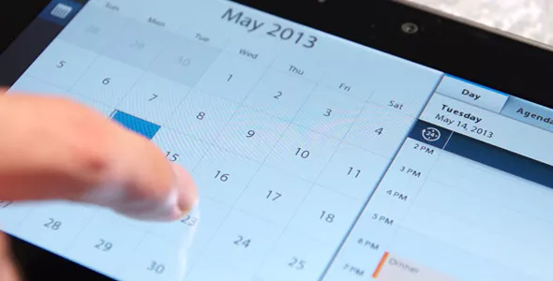
Seminè Fòmasyon pou Paran
Annakò avèk Plan Angajman Paran ak Fanmi, nou ta renmen envite w vin patisipe nan fòmasyon nan dat ki anba yo:
Learning Language Arts: 23 oktòb 2024
Math Mania: 22 janvye 2025
Notes:
Customize this slide to detail what your school is doing with Title I funds this year to increase student achievement for all students.
Be sure to include learning outcomes for parents and share what they can expect to learn from attending these interactive trainings.
Optional = Ask parents to enter these dates in their phone/calendar as save the date.

Slide 15
Kontra ant Paran ak Lekòl la
Chak lekòl Tit I dwe genyen yon Kontra ant Paran ak Lekòl la, men se paran, manm fanmi ak pèsonèl lekòl la ki pou ekri l.
Kontra ant Paran ak Lekòl la defini responsablite elèv, paran, manm fanmi ak estaf lekòl la nan fè efò pou ogmante rannman elèv la.
Notes:
Presenter dialogue –
An important part of the Parent and Family Engagement Plan is our School-Parent Compact. The Compact is also developed jointly with parents, family members and staff and outlines the responsibilities each have to raising student achievement.

Slide 16
Kontra ant Paran ak Lekòl la
Revizyon Kontra ant Paran ak Lekòl pou ane 2025
Ki sa lekòl la dakò; Ki sa paran an dakò; Sa elèv la dakò
Sijesyon pou Kontra ane pwochèn nan
Kesyon
Notes:
Share your school’s final Compact.
Share with parents:
the importance of the School-Parent Compact
how it was developed and
how it is going to be used to impact student achievement
the Compact will be revisited during ELEMENTARY parent-teacher conferences (as required by law)

Slide 17
Dwa Paran pou Konnen
Fanmi yo gen dwa pou poze kesyon:
Sou kalifikasyon pwofesyonèl pwofesè pitit yo;
ak
si yon moun ki pa pwofesè ap anseye pitit yo, nan ka sa a, kalifikasyon pwofesyonèl li.
Notes:
Presenter dialogue –
Title I schools must inform parents and family members of their rights. Parents and family members have the right to request information regarding their child’s teachers and paraprofessionals’ qualifications and their child’s academic level and growth on State assessments.

Slide 18
Dwa Paran pou Konnen
Yo dwe enfòme fanmi yo:
si yon pwofesè gen kat semèn oswa plis l ap anseye pitit yo san li pa satisfè kondisyon pou l anseye nivo klas oswa matyè l ap anseye a; ak
kòman pitit yo degaje yo nan egzamen leta tankou FSA, EOCs, ak SSA.
Notes:
Presenter dialogue –
Parents must be notified if their child has been taught for four or more weeks by a teacher who is licensed to teach in the State of Florida, but does not hold a certificate to teach the grade or subject listed above.
Parents must also be notified if their child has been taught for four or more weeks by a substitute teacher who is approved by the District to substitute teach, but does not hold a Florida Department of Education teaching certificate for the grade level or subject listed above.
School must share with parents their child’s assessments results (FSA, EOC and SSA).

Slide 19
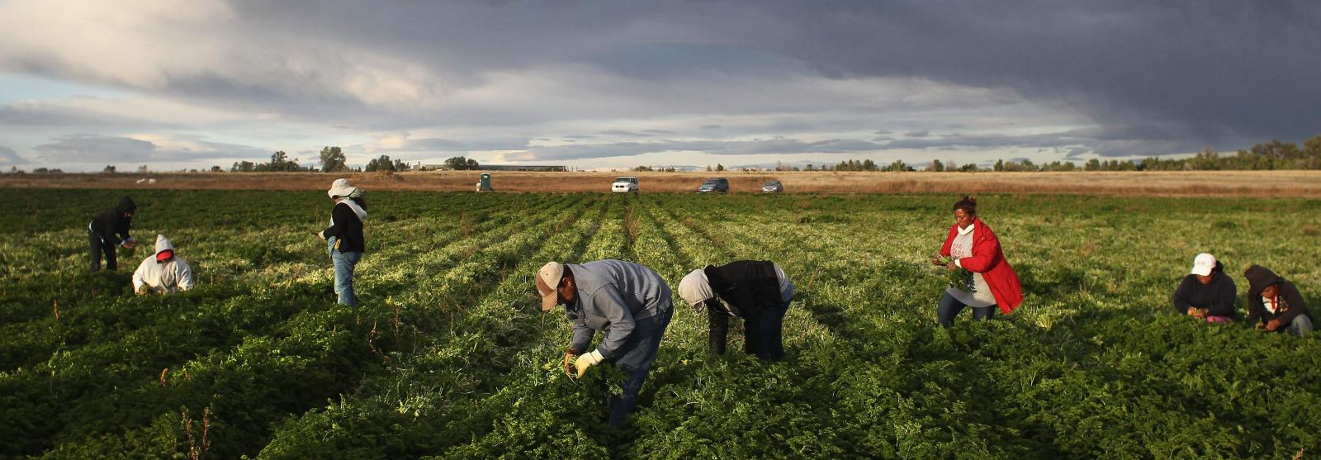
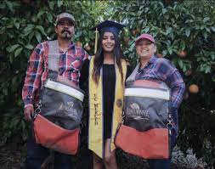
Pwogram Edikasyon Migran (MEP)
Bi Pwogram Edikasyon Migran an se pou ede tout elèv migran yo rive leve tout defi yo ka rankontre nan aktivite akademik yo, yon fason pou yo kapab gradye avek yon diplòm segondè (oswa pase pwogram GED) kap ede yo gen bon jan edikasyon kap prepare yo vin yon sitwayen responsab, gide yo nan sa yo pral aprann, ak rive fè siksè nan travay yo.

Slide 20
Pwogram Edikasyon Migran
Asire bezwen elèv migran yo satisfè e pou ede yo simonte:
entèripsyon nan lekòl
baryè kiltirèl ak lang
izole tèt ou yon kote apa
Manke resous sante
tranzisyon pou kolèj osinon al travay apre lekòl segondè
Pou amelyore opòtinite edikasyonèl elèv migran yo nan ede yo:
Sèvis akademik/sosyal siplemantè pou elèv yo ak fanmi yo
Tranzisyon nan nouvo lekòl (yo)
satisfè kontni akademik eta/distri ki difisil yo
gradye nan lekòl segondè
Notes:
Presenter dialogue –
The program provides supplemental academic and social support to migrant students and their families.

Slide 21
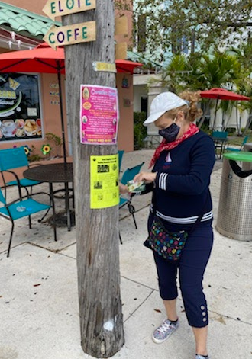
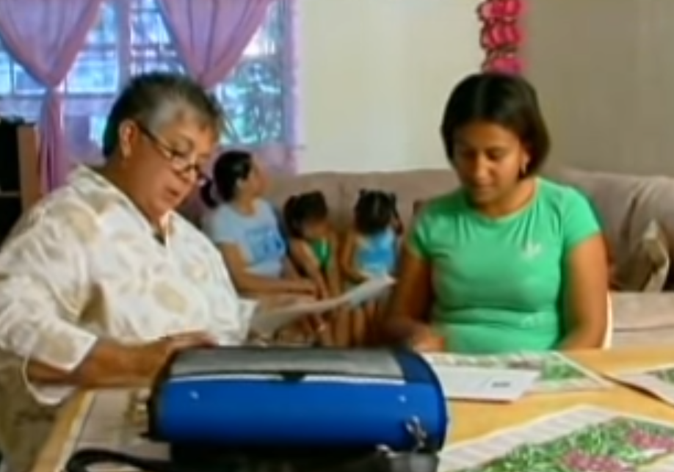
Premye etap se jwenn tout elèv migran yo
Entèvyou yo fèt an pèsòn pa yon Rekritè MEP ki resevwa fòmasyon pou itilize kondisyon kalifikasyon Federal ak Eta
Enfòmasyon pou Kontakte Pwogram nan:
Jorge Echegaray
Manadjè, Migrant Education Program
Depatman Edikasyon Miltikiltirèl
Jorge.Echegaray@palmbeachschools.org
(561) 202-0356

Slide 22
Elèv K ap Fè Eksperyans Sanzabri Tout Elèv Genyen Dwa pou Jwenn Edikasyon
Ekip McKinney-Vento Homeless Education Program (MVP) kapab ede fanmi k ap viv:
nan yon abri, motèl, machin, oswa sou teren kanpman;
nan la ri;
nan kay abandone oswa kay ki delabre;
nan motèl/otèl; oswa
abite tanporèman ak fanmi oswa zanmi akoz yon difikilte
Notes:
Presenter dialogue –
Anplis sèvis nou founi bay elèv migran yo, èske w konnen Distri nou an bay sipò tou ak sèvis pou elèv k ap fè eksperyans sanzabri?
Presenter dialogue –
In addition to the services that we provide to the migrant students, do you know that our District also provides support and services to students experiencing homelessness, including unaccompanied homeless youth? Unaccompanied homeless youth are homeless youth not in the physical custody of a parent or guardian.

Slide 23
Elèv K ap Fè Eksperyans Sanzabri
Tout lekòl genyen yon Moun ki se Kontak McKinney -Vento & Jesyonè Ka nan McKinney-Vento Homeless Education Program (MVP), k ap travay avèk fanmi pou:
bay lekòl founiti klasik, inifòm, sèvis adisyonèl ak manje gratis nan lekòl;
òganize transpò pou ale lekòl kote yo soti a epi retounen lakay;
jwenn sipò ak resous kominotè;
deside ki lekòl ki ta pi bon pou timoun nan;
kominike avèk lekòl la;
ak plis toujou.
Notes:
Presenter dialogue –
Yo fè tout efò posib pou konsantre sou bezwen elèv ak fanmi k ap fè eksperyans sanzabri. Fanmi yo kapab kontakte lekòl la pou jwenn plis enfòmasyon sou sèvis lekòl la ak Distri a bay.
Presenter dialogue –
Every effort is made to address the needs of students and families experiencing homelessness. Families can contact the school to find more information on the services the school and District provide.

Slide 24
Elèv K ap Fè Eksperyans Sanzabri
Enfòmasyon pou Kontakte MVP
Kontakte pwogram McKinney-Vento Homeless Education Program (MVP) oswa w ta renmen ranpli yon Kesyonè sou Lojman pou Elèv
(561) 350-0778
MVPhomeless@palmbeachschools.org

Slide 25
Konklizyon
Opòtinite pou paran poze kesyon ak bay opinyon
Konplete evalyasyon
Mèsi pou prezans, patisipasyon ak opinyon w.
Nou espere w pase yon bòn ane akademik!
Notes:
Presenter dialogue –
Ask if there are any questions.
Ask participants to complete evaluation using the link posted to school website under Annual Meeting.
Thank participants for attending.

